Slide 1
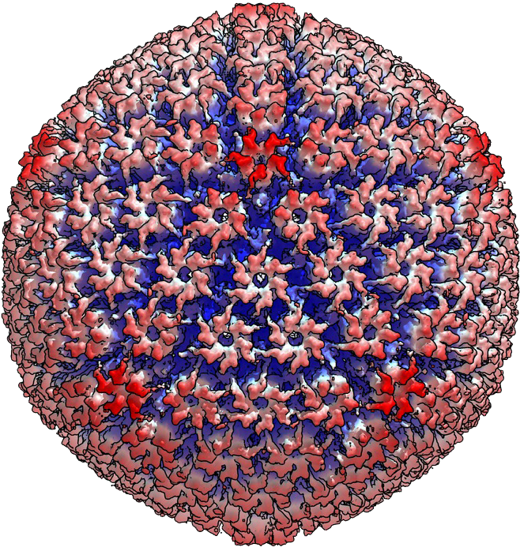
PLANS FOR A VIRUS CENTRE AT LUND UNIVERSITY
∞ LUND UNIVERSITY CENTRE FOR VIROLOGY RESEARCH
AIM
To create a regionally, nationally, and internationally well-known excellence centre for translational virus research in which experimental and clinical research meets in synergy

Slide 2
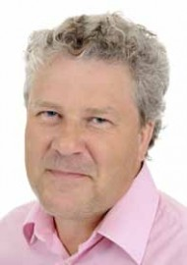
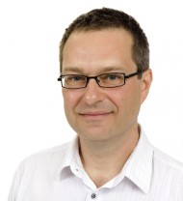
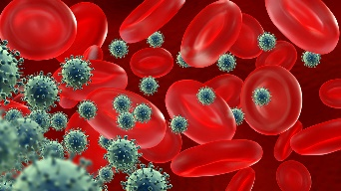
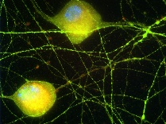
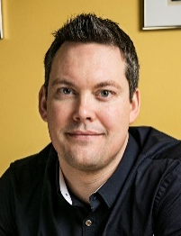
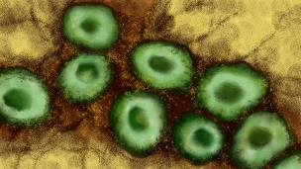
TODAY – FOUR RESEARCH TEAMS
Research team | PI | Department
Molecular Virology | Stefan Schwartz, Professor | ILM
Clinical Virology | Patrik Medstrand, Professor | ITM
Immunovirology | Marianne Jansson, Ass. Professor | ILM
Systems Virology | Joakim Esbjörnsson, Ass. Professor | ITM
Viruses
Airbourne
Influenza, Norovirus
Droplet transmission
Rotavirus
Bloodbourne/sexually transmitted
HIV, SIV, HBV, HCV, CMV, HPV
15 PhD students
10 postdocs/guest researchers
2 Technicians
Students
Other associates
-Retired Ass. Professor (Anders Widell)
-Clinical microbiology (Gulsen Özkaya-Sahin)
Latent
EBV, HHV, HSV
”Emerging” viruses
Chikungunya virus
Notes:
Vi tror att framtiden är att ha ett ämnesfokus oberoende av institutionstillhörighet
Klinisk relevans
Epidemiologi, cancer, transplantation, encefaliter, immunosuppression, diarré

Slide 3
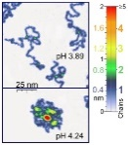
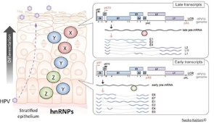
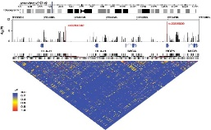
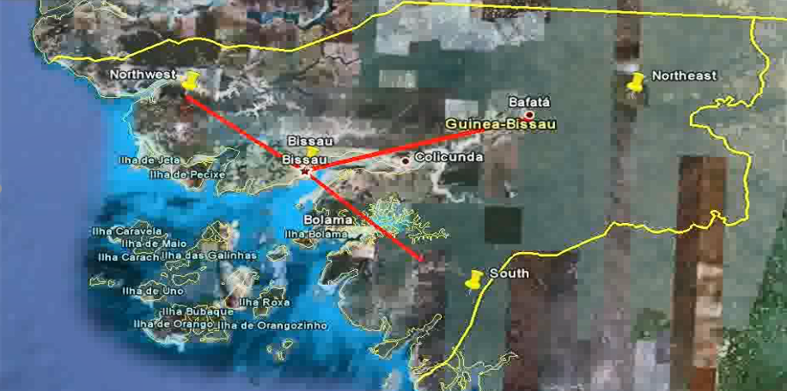
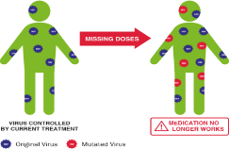
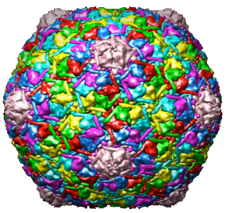
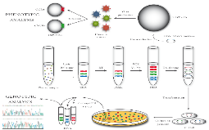
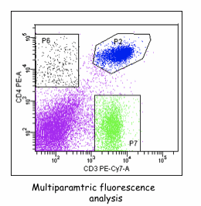
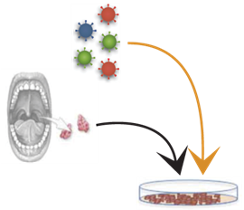
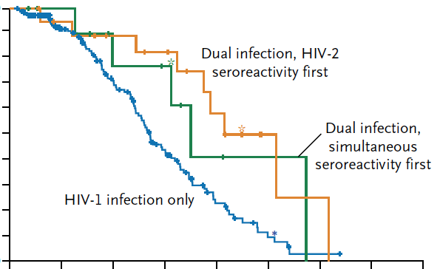
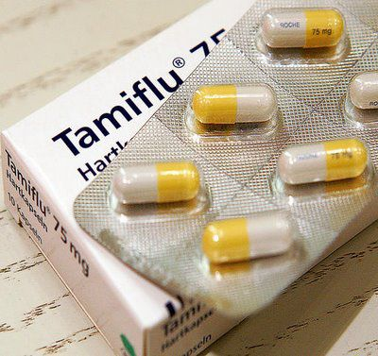
TOMORROW – VIROLOGY CENTRE
”From Angstrom to individual and population”
- alternatively: from one globe to another
Atomic Force Microscopy and SRFM (LU physics)
Multiplex immune marker analysis
Epidemiology
Viral gene regulation
Cluster analysis
Drug resistance – diagnosis/point-of-care
Genotype/phenotype linkage
Bioinformatics/phylogenetics
Pathogenesis
Small Angle X-ray and Neutron Scattering (ESS and MAX IV)
In vitro/Ex vivo
infection models
Discovery of antivirals
FACS
From Molecular and Experimental Virology to Immunovirology and Clinical Virology

Slide 4
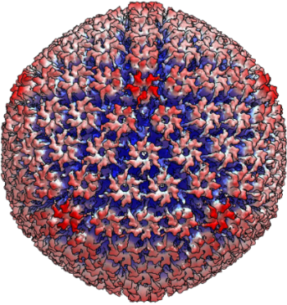
SYNERGIES WITH THE FORMATION OF A CENTRE
Co-localisation of infrastructure and personel
Technical equipment
Flexibility in the core functions of the centre
Guest researchers
Increased security for staff
Coordination
Administration
Working environment and human resources
Seminars and journal clubs
Competence development
Education
Program courses
PhD student courses
Workshops
Research school
A strong national and international profile
Recruitment of world-class researchers
Competitiveness for larger grants directed towards research centres
∞ LUND UNIVERSITY CENTRE FOR VIROLOGY RESEARCH
Notes:
Inriktningarna på de olika gruppernas forskning representerar en mycket bred spännvidd med starka kopplingar till både klinik och industri. En centrumbildning skulle effektivt skapa större trygghet för teknisk personal, möjliggöra en samordnad infrastruktur, bidra till en gemensam utbildningsstrategi inom virologi vid fakulteten, samt skapa förutsättningar för translationell forskning i världsklass.

Slide 5
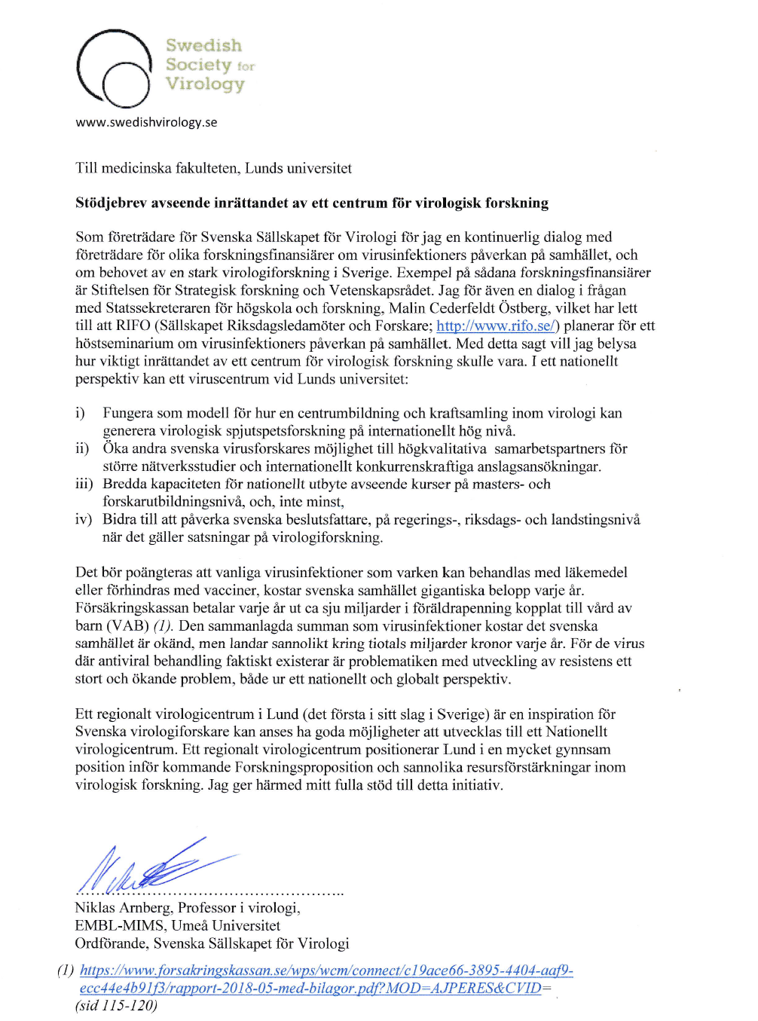
SUPPORTING LETTER
”A regional virology centre in Lund (the first of its kind in Sweden) is an inspiration for Swedish virology researchers with the possibility to develop into a National Virology Centre. A regional virology center positions Lund in a very favorable position for the forthcoming Research Proposal and probable resource investments in virus research in Sweden.”

Slide 6
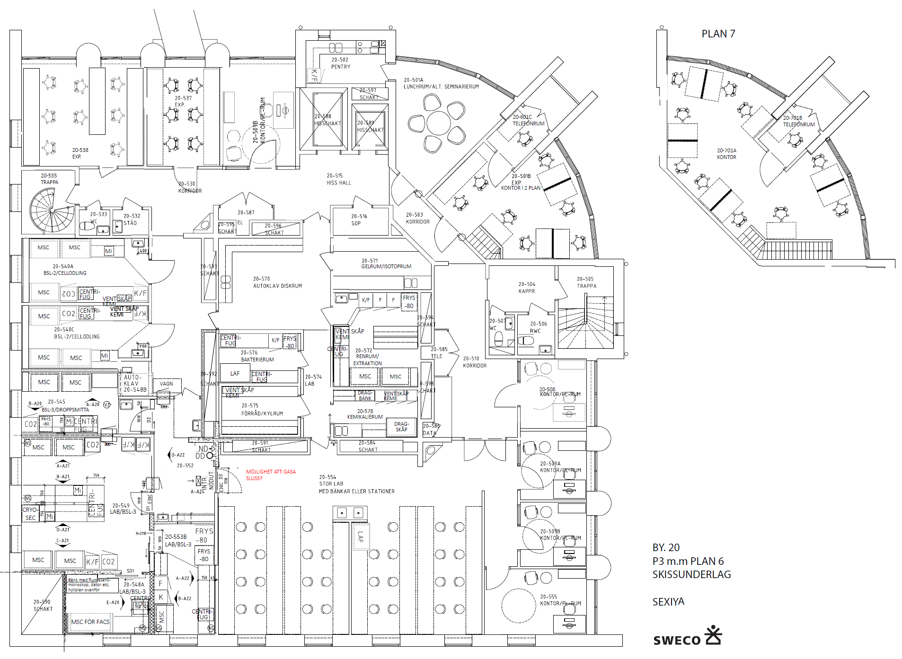
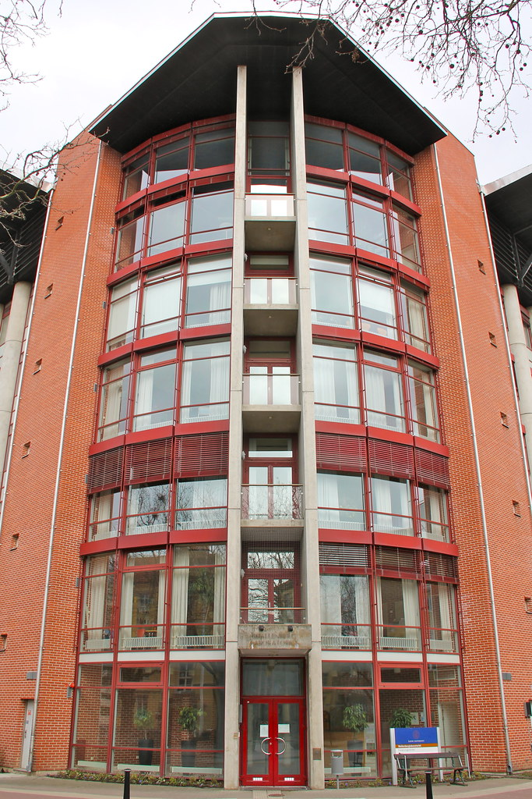
NOVEMBER 2021 – VIROLOGY CENTRE
Wallenberg Laboratory

Slide 7
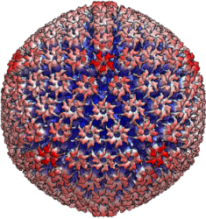
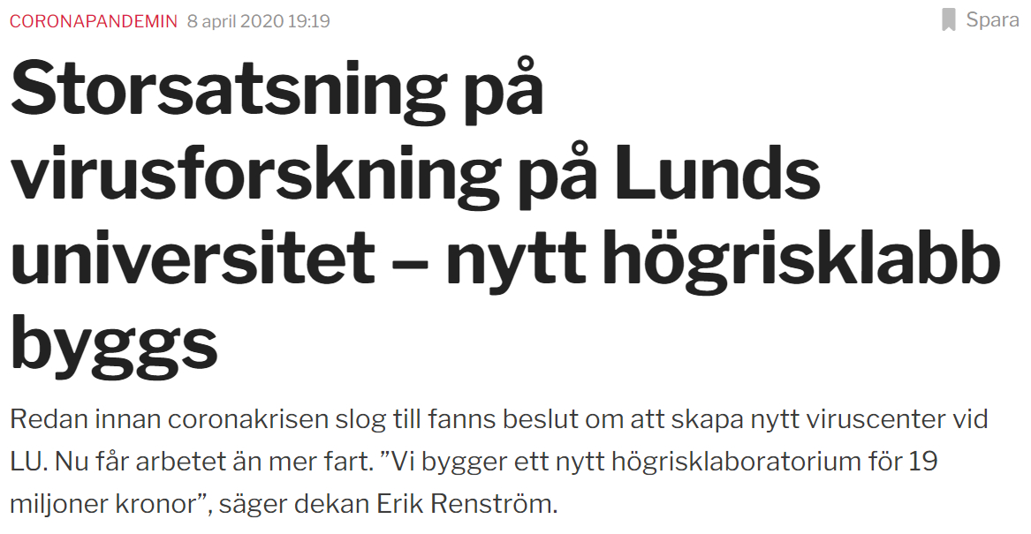
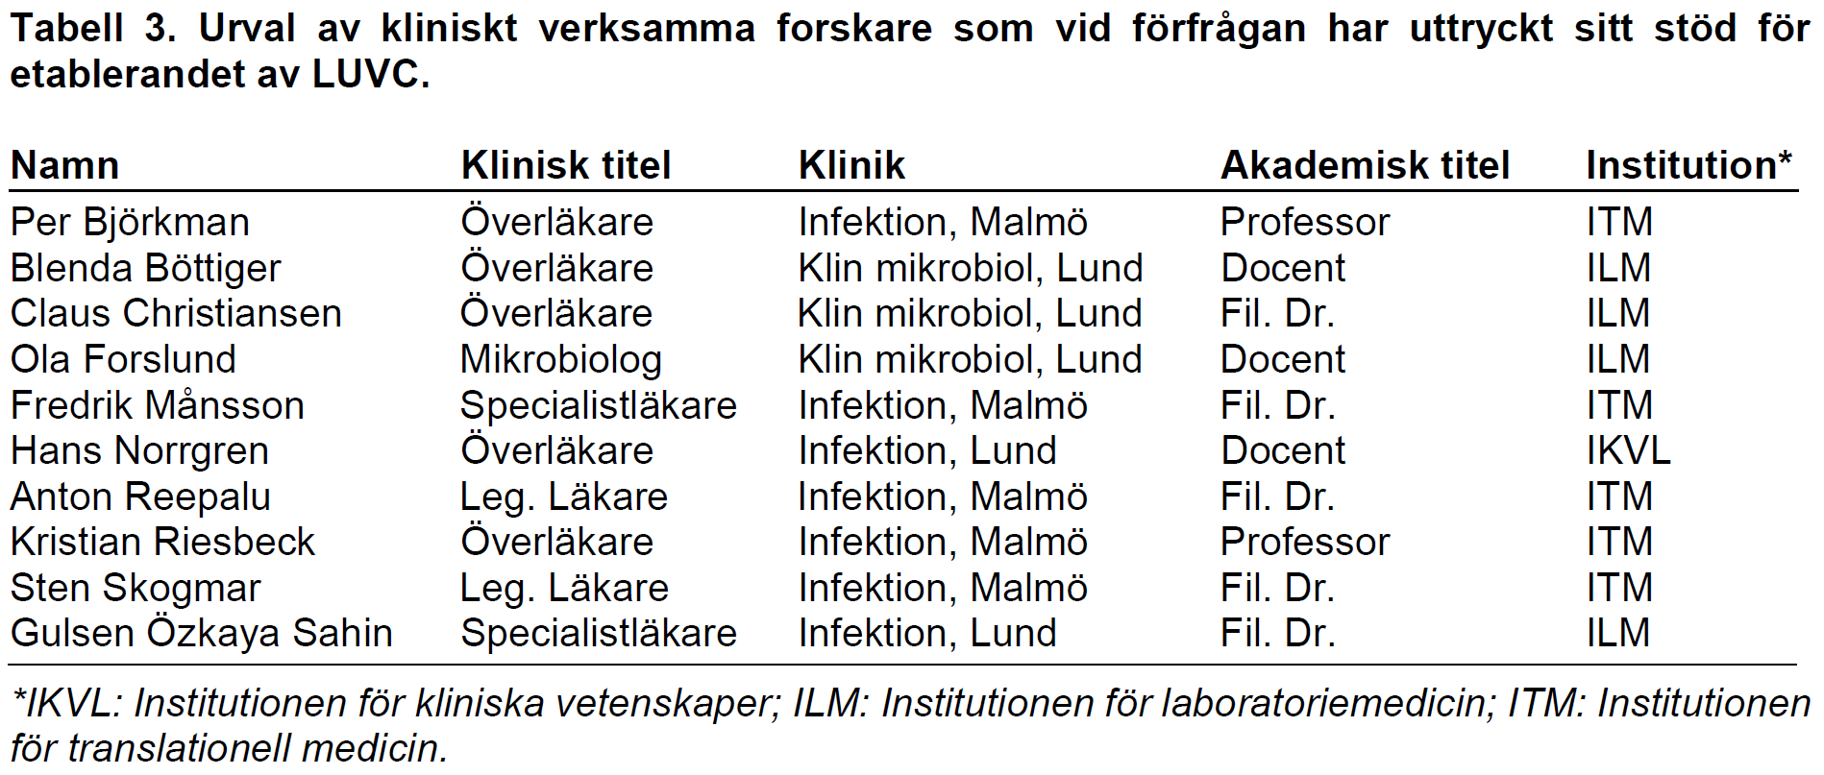
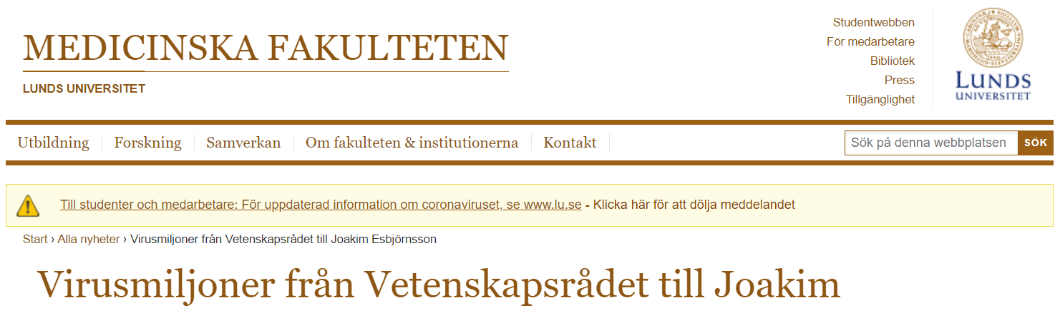
EXAMPLES OF RECENT IMPACT
∞ LUND UNIVERSITY CENTRE FOR VIROLOGY RESEARCH
Notes:
Vi tror att framtiden är att ha ett ämnesfokus oberoende av institutionstillhörighet
Klinisk relevans
Epidemiologi, cancer, transplantation, encefaliter, immunosuppression, diarré

Slide 8
REMAINING POINTS
∞ LUND UNIVERSITY CENTRE FOR VIROLOGY RESEARCH
Notes:
Vi tror att framtiden är att ha ett ämnesfokus oberoende av institutionstillhörighet
Klinisk relevans
Epidemiologi, cancer, transplantation, encefaliter, immunosuppression, diarré

Slide 9
CURRENT COLLABORATIONS AND NETWORK
Lund University-Adama Research site
SWEGUB CORE

Slide 10
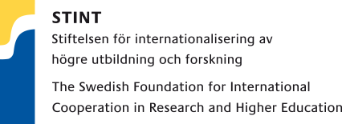
CURRENT GRANTS AND CONNECTIONS WITH INDUSTRY

Slide 11
VIROLOGY CENTRE
”From Angstrom to individual and population”
- alternatively: from one globe to another
Atomic Force Microscopy and SRFM (LU physics)
Multiplex immune marker analysis
Epidemiology
Viral gene regulation
Cluster analysis
Drug resistance – diagnosis/point-of-care
Genotype/phenotype linkage
Bioinformatics/phylogenetics
Pathogenesis
Small Angle X-ray and Neutron Scattering (ESS and MAX IV)
In vitro/Ex vivo
infection models
Discovery of antivirals
FACS
From Molecular and Experimental Virology to Immunovirology and Clinical Virology

